Slide 1
Dual Enrollment
Info Session

Slide 2
Earlier Registration*
Specialized DE Advisors
Access to KSU Resources
Streamlined DE student to freshman pathway in senior year
Benefits of Dual Enrollment at KSU

Slide 3
Classification
High School Junior or Senior
3.0 Core GPA
2 Units of English, Math, Science and 1 Unit of Social Science
SAT
500 EBRW| 490 Math| 1050 Total Score
ACT
18 English or Reading | 18 Math |20 Composite
Admissions
Requirements

Slide 4
1. Apply To Kennesaw State
admissions.kennesaw.edu
Apply as a DE student
Include your SSN
2. Submit an Official High School Transcript
Homeschool Portfolio (if applicable)
Submit official college transcript if previously DE
3. Submit Official Test Scores and AP Scores
4. Dual Enrollment Form
New Student and Policy Form
5. Complete DE Funding Application
gafutures.org
Include your SSN
Admissions
Checklist

Slide 5
Admissions
Deadlines
Semester | Application Deadline | Document Deadline | Classes Begin
Spring 2023 | November 1, 2022 | November 18, 2022 | January 9, 2023
Summer 2023 | March 31, 2023 | April 14, 2023 | May 15, 2023
Fall 2023 | April 14, 2023 | April 28, 2023 | August 14, 2023

Slide 6
Kennesaw or Marietta Campus
Monday (M), Wednesday ( W)
Tuesday (T), Thursday (TR)
Monday, Wednesday, Friday (MWF)
Hybrid (Face to Face and online combination)
Online (all materials and coursework online)
Class Offerings

Slide 7
Dual Enrollment Funding cap is 30 Semester credit hours
Funding pays 100% of a student's tuition, student fees, and required book rental
Funding only covers approved Courses
Core academic areas (English, Math, Science, Social Science, and World Languages)
Career, Technical, and Agricultural (CTAE) Courses
Fine Arts, Physical Education, and Health no longer eligible for Funding
No funding rewarded for the same course taken twice
Students are ineligible for DE funding after their 2nd course withdrawal
Dual Enrollment Funding

Slide 8
What will be your funding responsibility?
Course lab Fees
Proctored exams for online classes
( $8-30 per test)
Scantrons
Non-funded Courses & Self-pay courses
Responsible for tuition, student fees, and books
Parking (if you are attending F2F Classes)
Housing and Meal Plans (optional)
Dual Enrollment Funding

Slide 9
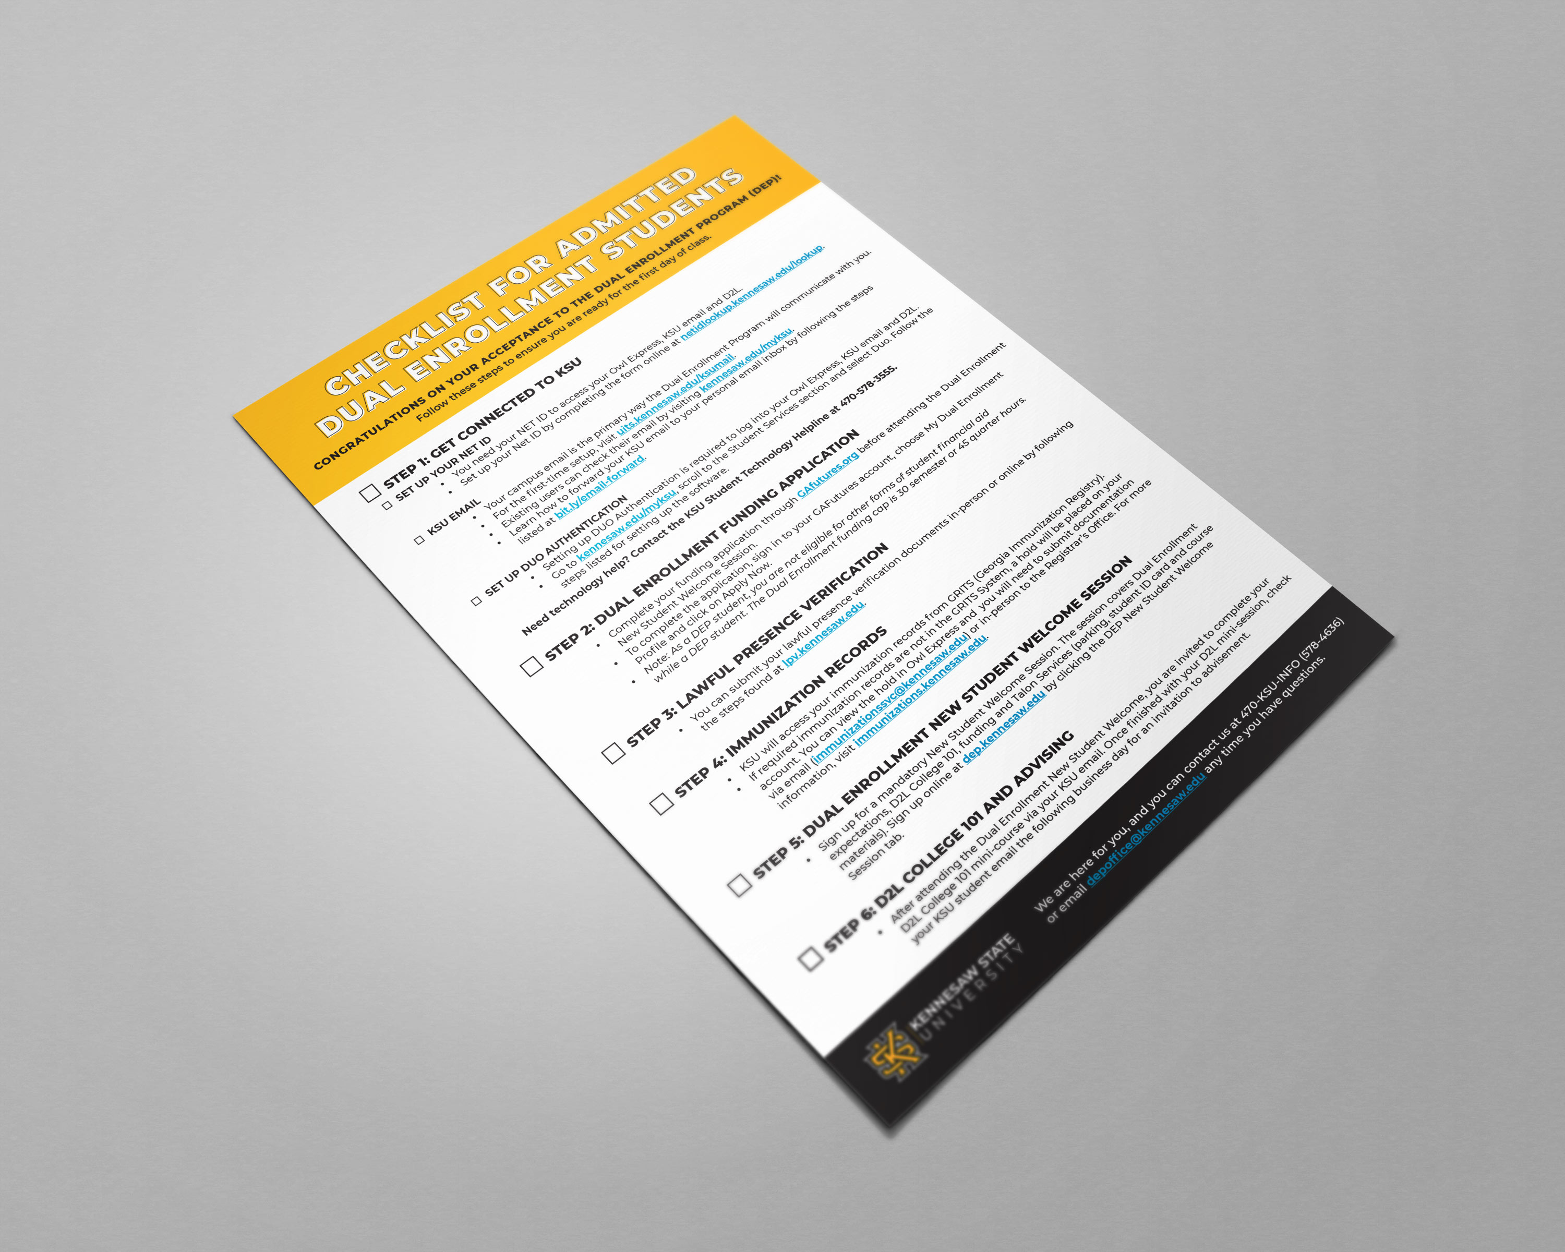
After Acceptance

Slide 10
Meet with your high school counselor to determine your DE classes
Submit your funding application before applying to your DE College of Choice
Your funding application is not the same as your DE College admission application
Use your campus resources for tutoring if you are falling behind in classes
A GPA lower than a 2.0 is an automatic dismissal from KSU’s DE program.
Reminders

Slide 11
VISIT KSU!
Guided Campus Tours • Monday-Friday 10 AM & 1 PM • Kennesaw and Marietta Campus

Slide 13
Questions?
Email: depoffice@kennesaw.edu Website: dep.kennesaw.edu

