Slide 1
Coach Knight
Geometry
&
Algebra 1

Slide 2
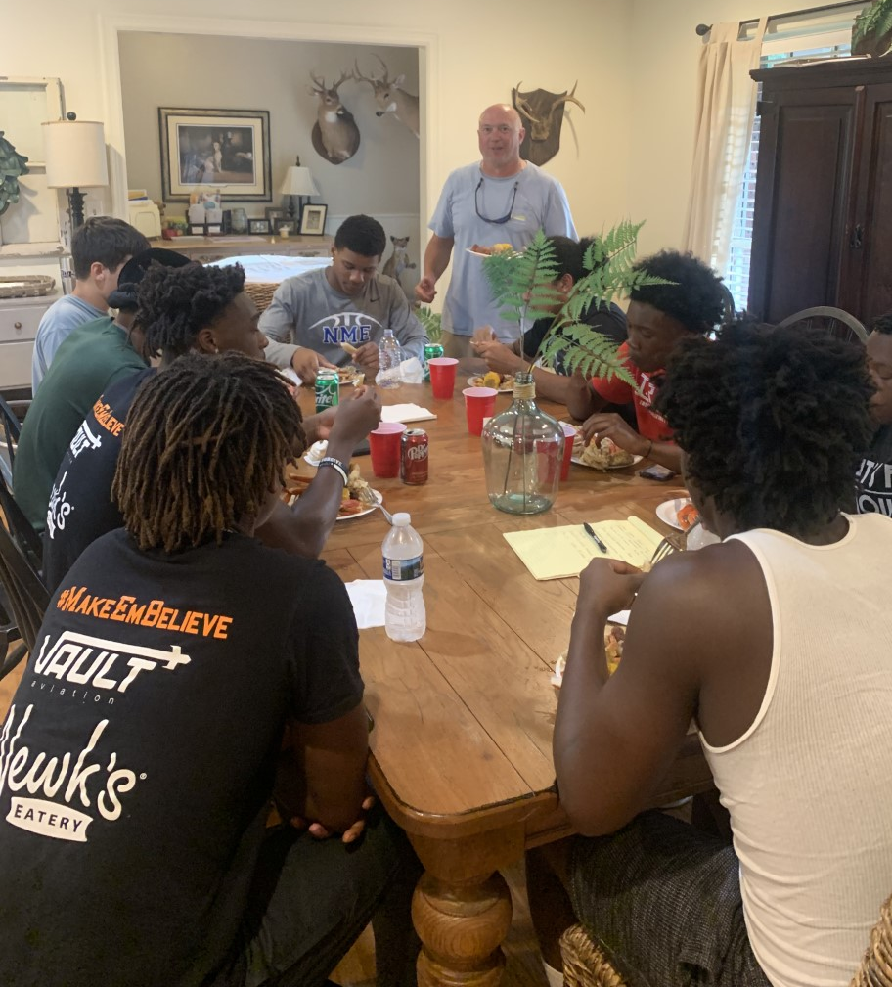
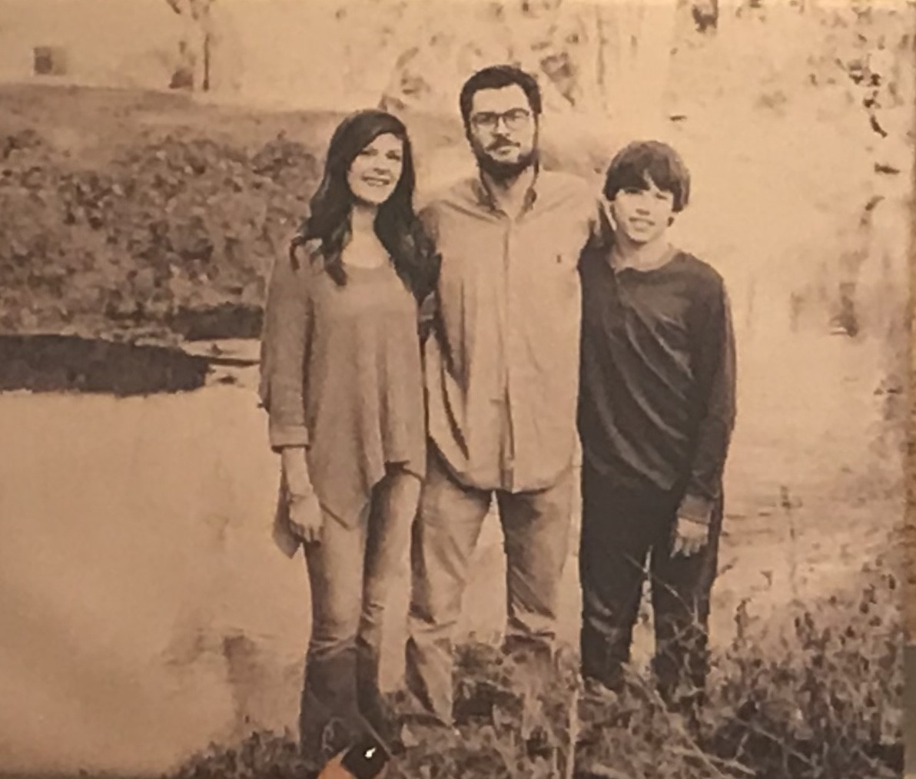
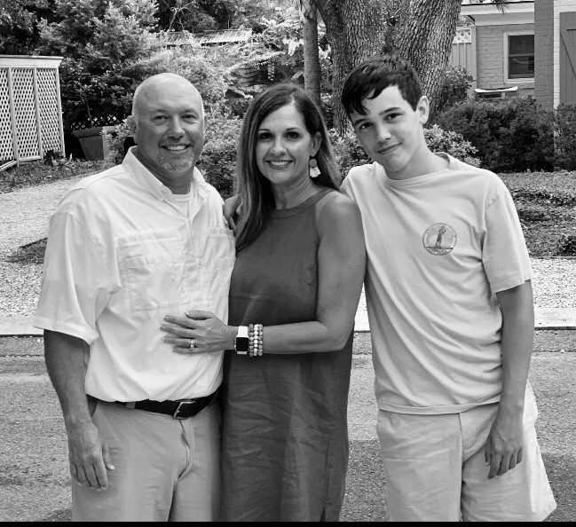
Family Kim, Dillon, ivey, jud, & football

Slide 3
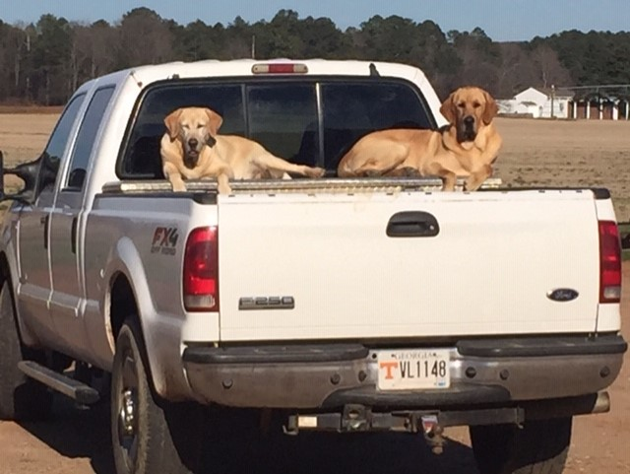
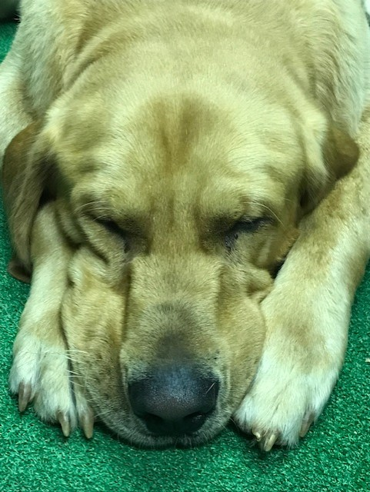
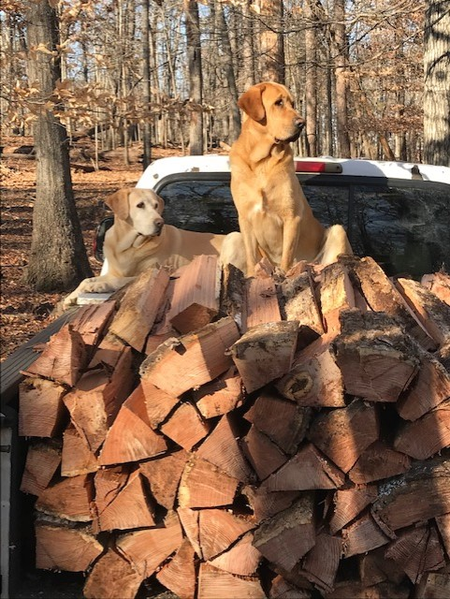
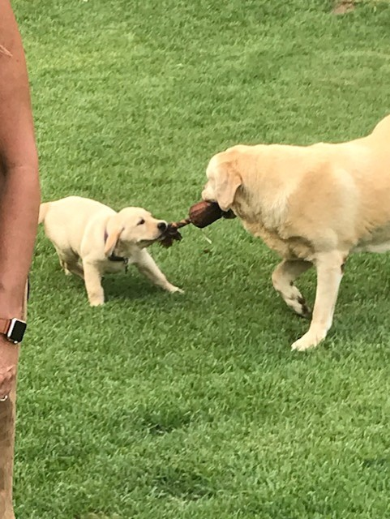
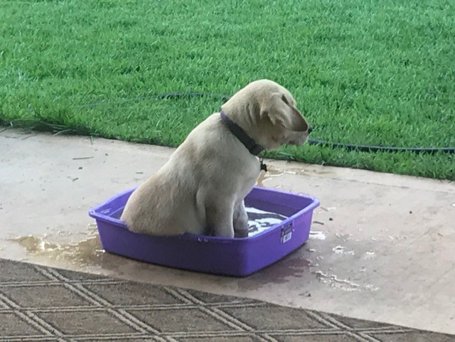
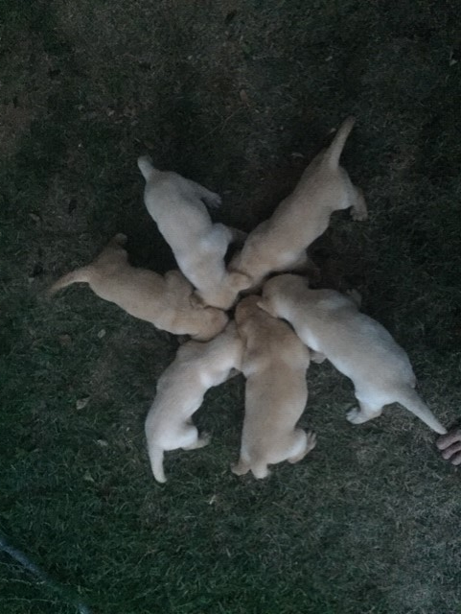
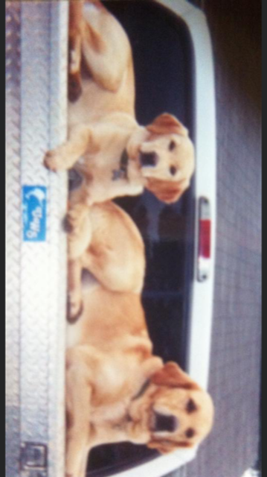
My other kids
Sweetie, Muzzy, & remi jo

Slide 4
Hobbies and interest
Spending time with family
Hunting
Fishing
Camping
Boating
All sports
Music/concerts
Grilling/smoking
Skydiving
Zip lining
Traveling
College football
Construction projects
CORN HOLE

Slide 5
