Slide 1
What causes weather to change?
The movement of air and moisture in the atmosphere cause weather to constantly change.
Notes:
Instructional Approach(s): The teacher should present the information on the slide.

Slide 2
Learning Target: How does the interaction between air masses cause a change in the weather?
Notes:
Instructional Approach(s): The teacher should introduce the essential question for the lesson.

Slide 3
Standards:
S6E4a. Demonstrate that land and water absorb and lose heat at different rates and explain the resulting effects on weather patterns.
S6E4b. Relate unequal heating of land and water surfaces to form large global wind systems and weather events such as tornados and thunderstorms.
S6E4c. Relate how moisture evaporating from the oceans affects the weather patterns and weather events such as hurricanes.
Notes:
Instructional Approach(s): The teacher should introduce the standards that are aligned to the essential question.

Slide 4
Air Masses
An air mass is a large body of air that has properties similar to the part of Earth’s surface over which it develops.
Notes:
Instructional Approach(s): The teacher should present the information on the slide while the students record the information on their notes.

Slide 5
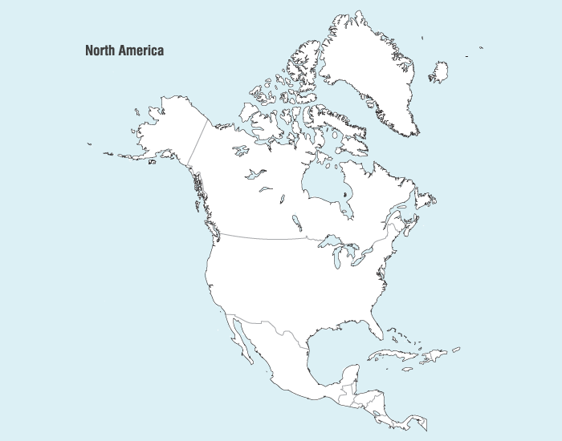
Cool/Moist Air
Cool/Moist Air
Cold/Dry Air
Hot/Dry Air
Warm/Moist Air
Warm/Moist Air
Notes:
Instructional Approach(s): Have students turn to a partner and discuss the question on the slide. Partners can be determined by the students or the teacher can provide more specific directions such as turn to the person directly in front/behind you or to the right/left of you, etc. It may be necessary to have a group of three if you have an uneven number of students. Do not allow more than 30 seconds to 1 minute of discussion time. The teacher should be walking around listening and redirecting discussions as needed. The teacher can briefly discuss student responses. Students should use the diagram to label the map on their own notes and answer a few questions on the notes.

Slide 6
Cold temperatures have higher density and higher pressure.
Warm temperatures have a lower density and lower pressure.
Cool/Moist Air
Cool/Moist Air
Cold/Dry Air
Hot/Dry Air
Warm/Moist Air
Warm/Moist Air
Notes:
Instructional Approach(s): The teacher should pose the question to the class or call on students to respond. Students should apply their knowledge from previous lessons to answer the question. In general, you want students to remember that cold temperatures have higher density/higher pressure and warm temperatures have lower density/lower pressure.

Slide 7
High pressure areas are associated with fair weather. Why?
Notes:
Instructional Approach(s): The teacher should present the information to the class. The teacher can pose the question to the class and briefly discuss their responses, or the teacher can click to the next slide to discuss the answer.

Slide 8
The sinking motion of air in high pressure (low temperature, high density) air masses makes it difficult for air to rise and clouds to form.
Notes:
Instructional Approach(s): The teacher should present the information on the slide while the students answer the question on their notes.

Slide 9
Low pressure systems (warmer temperatures and lower density) are areas of rising air.
Clouds form when air is lifted and cools. Therefore, areas of low pressure usually have cloudy weather.
Notes:
Instructional Approach(s): The teacher should present the information on the slide while the students answer the question on their notes.

Slide 10
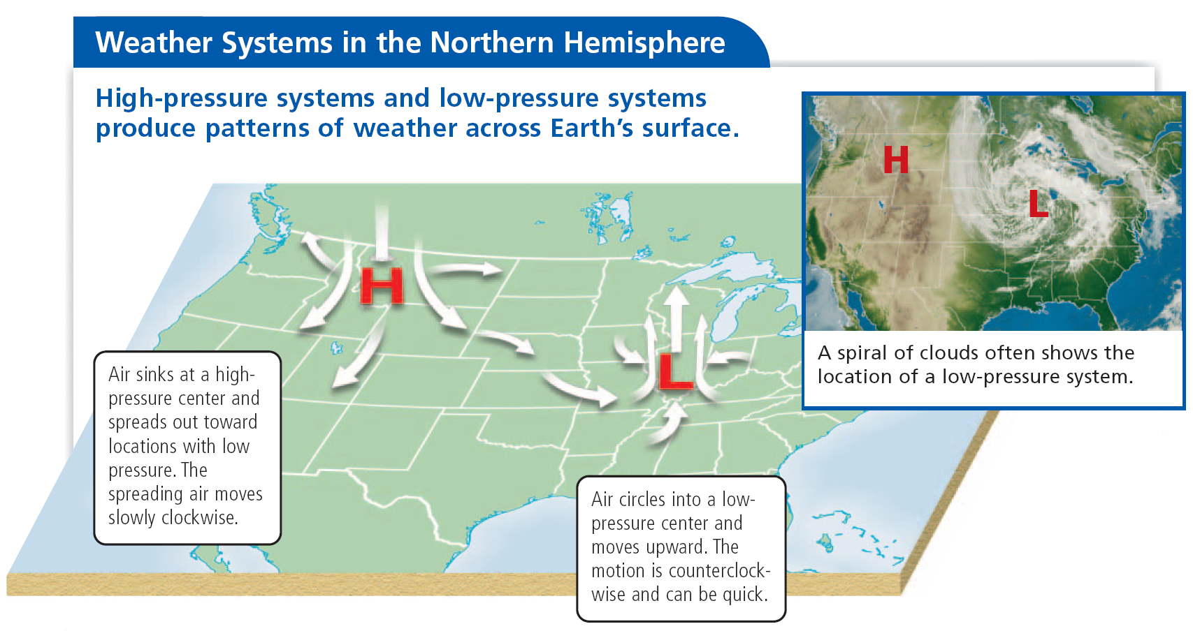
Notes:
Instructional Approach(s): The teacher should use the diagram to illustrate the concepts of high pressure/clear skies and low pressure/cloudy skies.

Slide 11
Fronts
A boundary between two air masses of different density, moisture, or temperature is called a front.
Notes:
Instructional Approach(s): The teacher should present the information on the slide while the students answer the question on their notes.

Slide 12
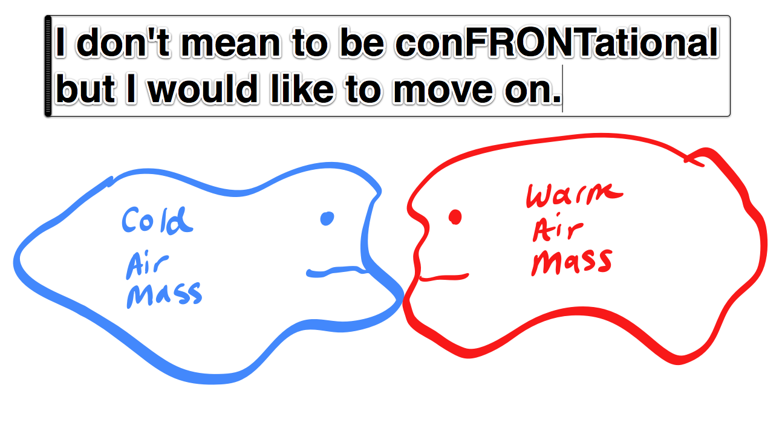
Notes:
Instructional Approach(s): The teacher should use the funny slide to reinforce the meaning of front.

Slide 13
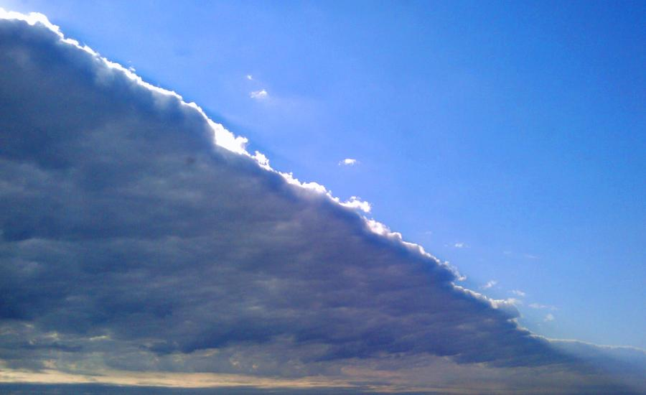
Fronts
Which side of this front is most likely warmer? How do you know?
Notes:
Instructional Approach(s): The teacher should pose the question to the class and briefly discuss student responses.

Slide 14
Cloudiness, precipitation, and storms sometimes occur at frontal boundaries.
Notes:
Instructional Approach(s): The teacher should present the information on the slide while the students answer the question on their notes.

Slide 15
There are different types of fronts. We are going to examine just two: Cold and Warm Fronts
Notes:
Instructional Approach(s): The teacher should present the information on the slide.

Slide 16
Cold Front
A cold front occurs when colder air advances toward warm air. The cold air wedges under the warm air.
As the warm air rises, it cools and condenses forming clouds. Thunderstorms often form as warm air is suddenly lifted.
Notes:
Instructional Approach(s): The teacher should present the information on the slide while the students answer the question on their notes.

Slide 17
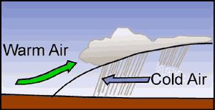
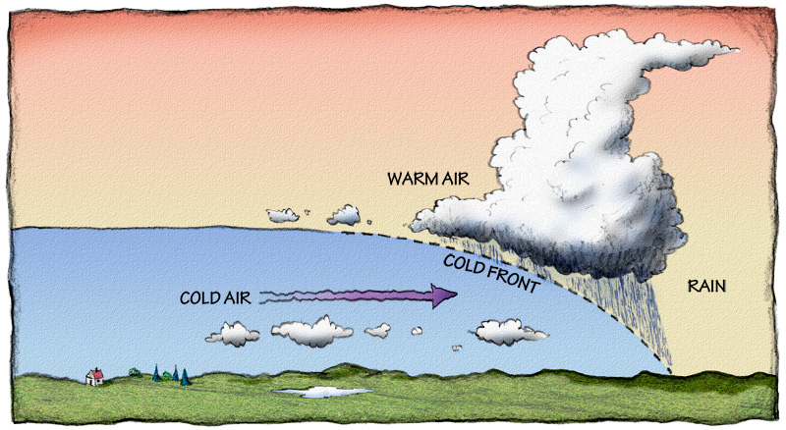
Cold Front
Notes:
Instructional Approach(s): The teacher should use the images to illustrate a cold front.

Slide 18
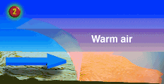
Cold Front Advancing
Notes:
Instructional Approach(s): The teacher should use the animation to illustrate a cold front advancing.

Slide 19
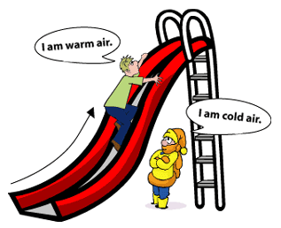
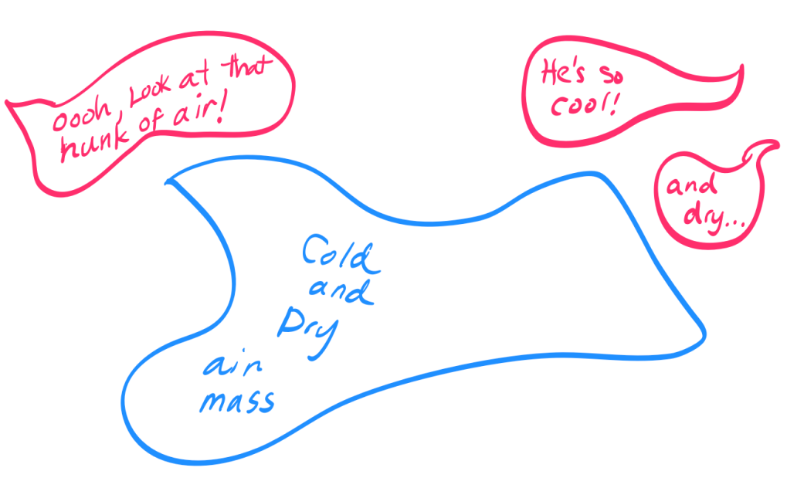
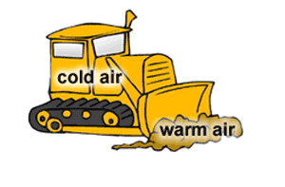
Cold Front
Notes:
Instructional Approach(s): The teacher should use the pictures to reinforce cold air sinking or being beneath warm air. The teacher may want to discuss the bull dozer image and how it could illustrate an advancing cold front.

Slide 20
Warm Front
A warm front occurs when lighter, warmer air advances over heavier, colder air.
Can lead to long periods of gentle precipitation.
Notes:
Instructional Approach(s): The teacher should present the information on the slide while the students answer the question on their notes.

Slide 21
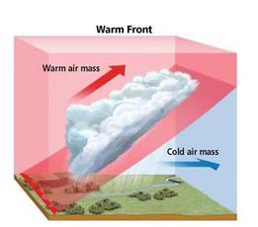
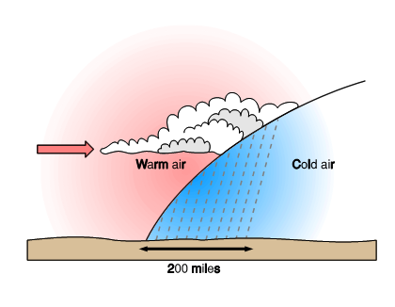
Warm Front
Notes:
Instructional Approach(s): The teacher should use the diagrams to illustrate a warm front approaching.

Slide 22
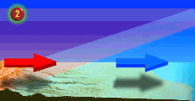
Warm Front Advancing
Notes:
Instructional Approach(s): The teacher should use the animation to illustrate a warm front advancing.

Slide 23
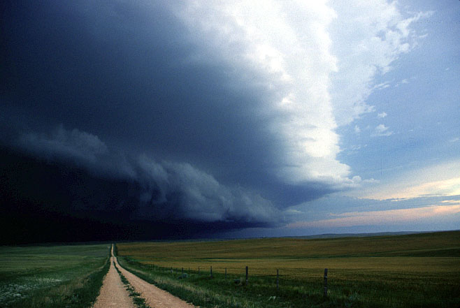
When the temperature difference between the cold and warm air is large, thunderstorms and even tornadoes may form.
Notes:
Instructional Approach(s): The teacher should present the information on the slide while the students answer a question on their notes.

Slide 24
Thunderstorms can form at a cold front or within an air mass.
At a cold front, air can be forced upward quickly. Within an air mass, uneven heating can produce convection and thunderstorms.
Notes:
Instructional Approach(s): The teacher should present the information on the slide.

Slide 25
Formation of a Thunderstorm
Thunderstorms get their energy from humid air. When warm, humid air near the ground moves vertically into cooler air above, the rising air, or updraft, can build a thunderstorm quickly.
Notes:
Instructional Approach(s): The teacher should present the information on the slide.

Slide 26
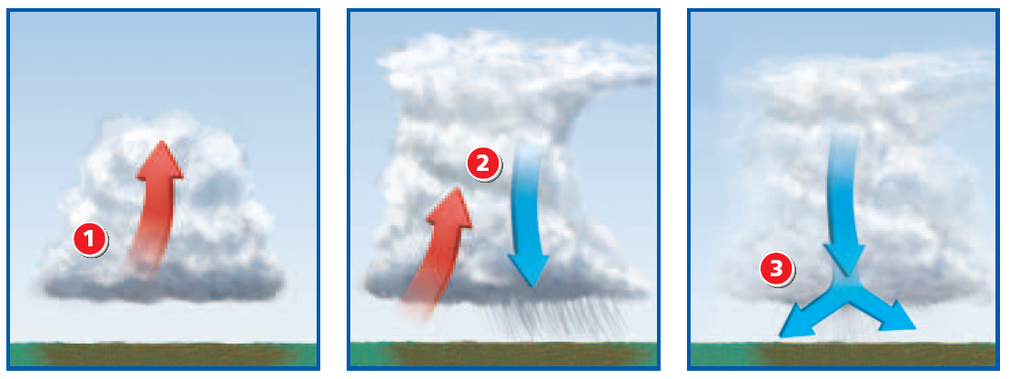
Formation of a Thunderstorm
1. Rising humid air forms a cloud. The water vapor releases energy when it condenses into cloud droplets. This energy increases the air motion. The cloud continues building up into the tall cloud of a thunderstorm.
2. Ice particles form in the low temperatures near the top of the cloud. As the ice particles grow large, they begin to fall and pull cold air down with them. This strong downdraft brings heavy rain or hail—the most severe stage of a thunderstorm.
3. The downdraft can spread out and block more warm air from moving upward into the cloud. The storm slows down and ends.

Slide 27
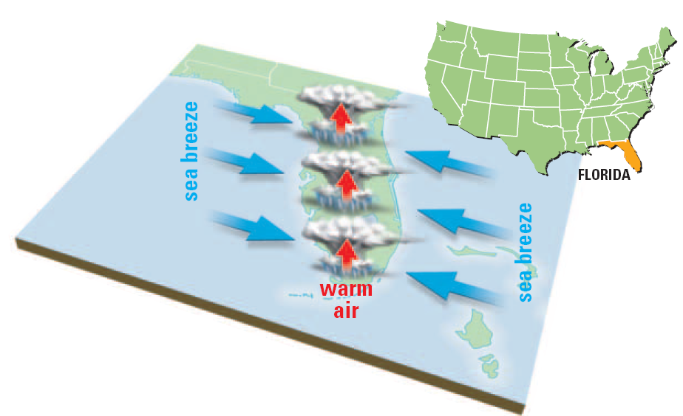
Formation of a Thunderstorm
In some regions, the conditions that produce thunderstorms occur almost daily during part of the year.
In Florida, for example, the wet land and air warm up during a long summer day. Then, as you see in the diagram, cool sea breezes blow in from both coasts of the peninsula at once. The two sea breezes together push the warm, humid air over the land upward quickly. Thunderstorms form in the rising air.

Slide 28
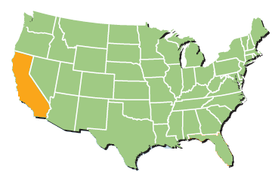
Formation of a Thunderstorm
California, along the western coast, does not have thunderstorms in the summer like Florida. Why might this be the case? What important factor in the formation of a thunderstorm would California be missing?
In contrast, the summer air along the coast of California is usually too dry to produce thunderstorms. The air over the land heats up, and a sea breeze forms, but there is not enough moisture in the rising warm air to form clouds and precipitation.

Slide 29
Tornadoes
In severe thunderstorms, wind at different heights blows in different directions and at different speeds.
This difference in wind speed and direction creates a rotating column parallel to the ground. If a thunderstorm tilts the column upward, a funnel cloud is created.
Notes:
Instructional Approach(s): The teacher should present the information on the slide while the students answer the question on their notes.

Slide 30
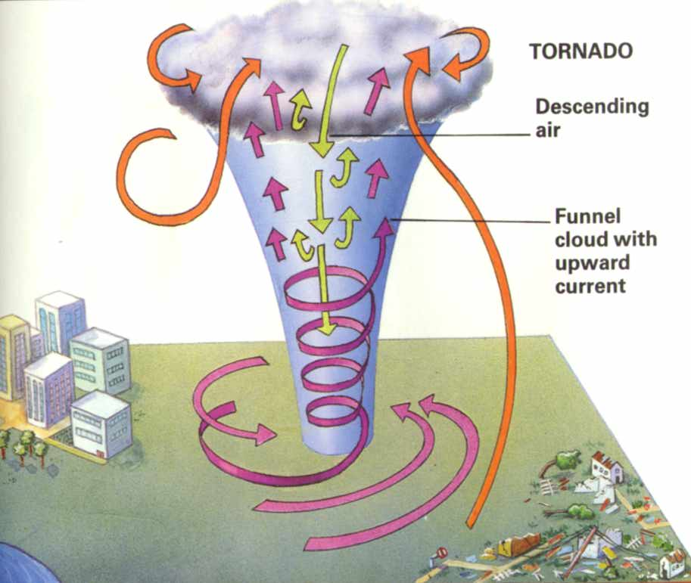
Notes:
Instructional Approach(s): The teacher should use the diagram to illustrate the formation of a tornado.

Slide 31
Large thunderstorms and tornadoes occur most frequently in the spring and summer. Why?
The ground is warming and warm air masses move north from Mexico, while cold air masses move south from Canada.
Notes:
Instructional Approach(s): The teacher should present the information on the slide while the students answer a question on their notes.

Slide 32
Hurricanes
A hurricane is a large, swirling, low pressure system that forms over the warm Atlantic Ocean. It is the most powerful storm.
Notes:
Instructional Approach(s): The teacher should present the information on the slide while the students answer a question on their notes.

Slide 33
Hurricanes
The strongest hurricanes affecting North America usually begin as a low pressure system west of Africa.
The storms gain strength from the heat and moisture of warm ocean water.
Notes:
Instructional Approach(s): The teacher should present the information on the slide while the students answer a question on their notes.

Slide 34
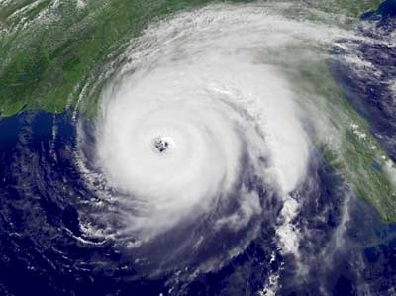
Notes:
Instructional Approach(s): Satellite image of a hurricane.

Slide 35
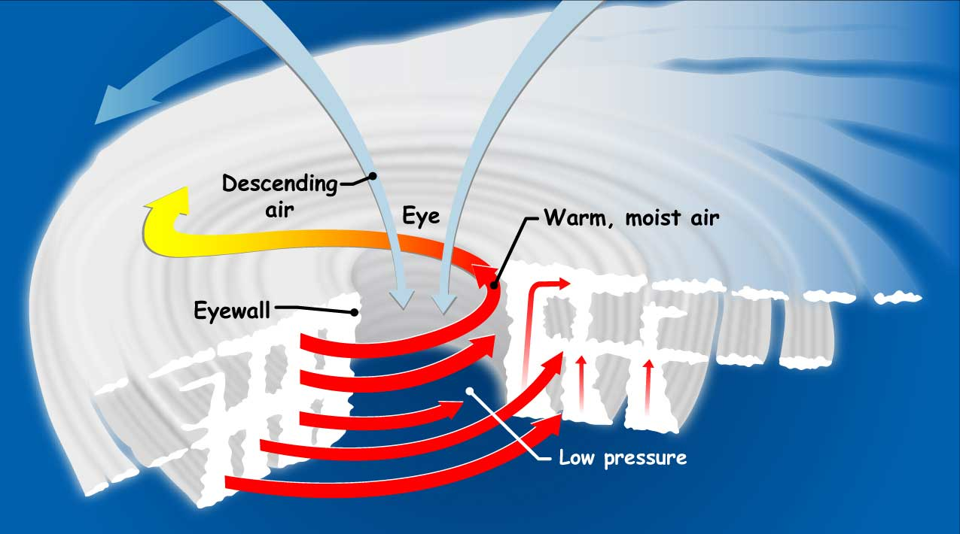
Hurricane
Notes:
Instructional Approach(s): The teacher should use the diagram to illustrate the formation of a hurricane.

Slide 36
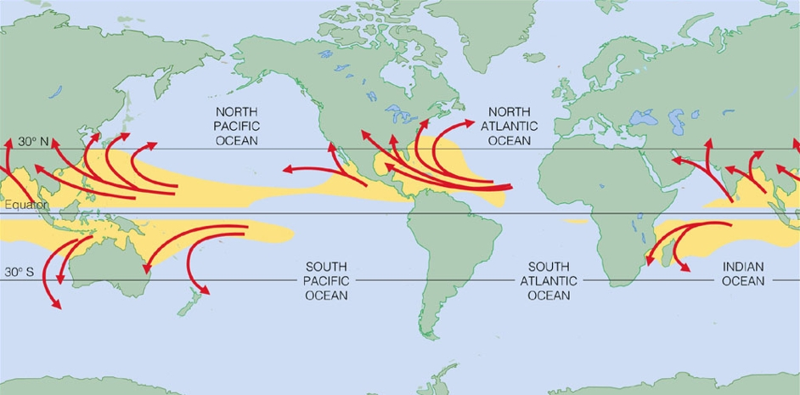
Typical Travel Paths of Hurricanes Why?
Notes:
Instructional Approach(s): The teacher should use the diagram to show the travel path of hurricanes. Pose the question to the class and briefly discuss student responses. When ready, click to the next slide to reveal the answer.

Slide 37
Hurricanes are fueled by the heat and moisture of warm ocean water.
Notes:
Instructional Approach(s): The teacher should present the information on the slide while the students answer a question on their notes.

Slide 38
Activating Strategy:
Watch the video below. Describe your observations and possible causes of such events.
https://www.youtube.com/watch?v=SZcBlAjf2NE
Notes:
Instructional Approach(s): The teacher should show the video clip and discuss the observations and possible causes with students

Slide 39
Summarizing Strategy
Notes:
Instructional Approach(s): Each student should complete the summarizer. The teacher should use the summarizer to determine the level of student mastery and if differentiation is needed.

